Slide 1
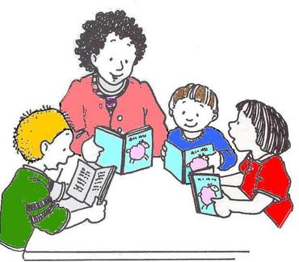
Literacy Update
School Board Meeting
January 12, 2015
Vikki Stevenson

Slide 2
Pre-k
Increasing oral language development
Literature discussions, asking and answering questions, and using complete sentences when speaking
Interactive Writing
Drawing and Labeling pictures
Naming letters and corresponding sound

Slide 3
Pre-k Interactive Writing
Notes:
Interactive writing to fill in the missing words. All students read after one student assists.
One student comes up and circles all of the Tt’s (letter of the week). Asks a friend to assist her.

Slide 4
Pre-K Math
Notes:
How to make 4 on tens frame. Patterns.

Slide 5
Kindergarten
Interactive Writing
Independent writing
Reading independently
Book discussions

Slide 6
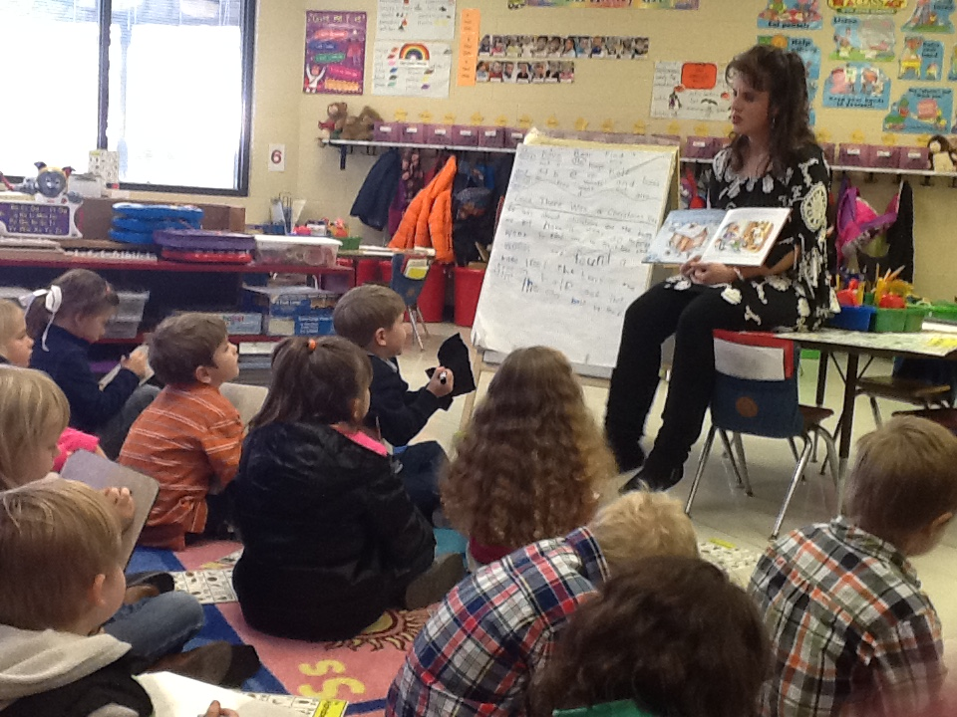
Kindergarten Guided Reading/Read Aloud/Interactive Writing

Slide 7
Kindergarten “I am thankful for soldiers.”

Slide 8
Kindergarten writing First, next, then, last stories
Notes:
First I get the blocks. Next I think about what I was building. Then I built my castle. Last I smiled a big good smile.

Slide 9
Early Reading Intervention
Notes:
Beginning of the year to December.

Slide 10
Early Reading Intervention
Notes:
Beginning of the year to December

Slide 11
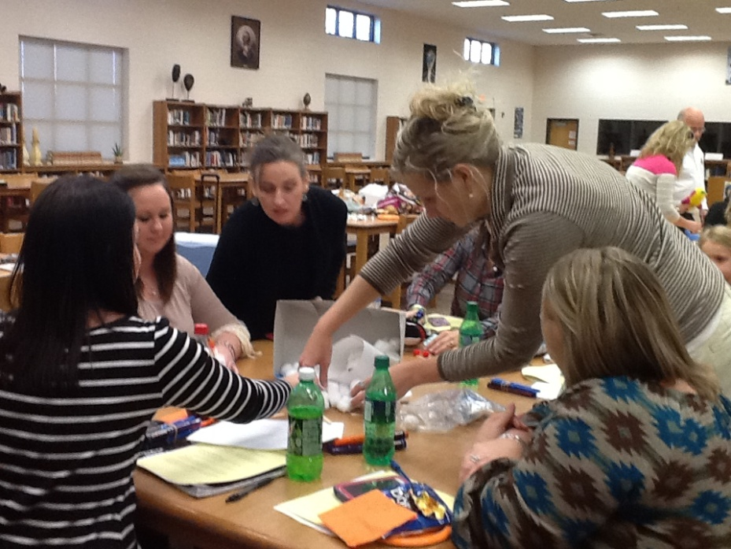
STEM activity- new teachers

Slide 12
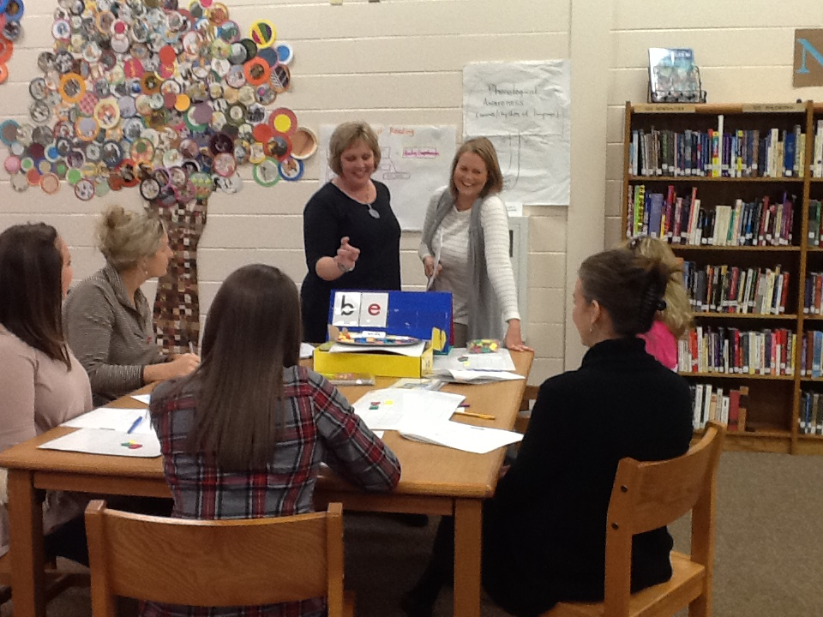
PD session on Literacy Elementary

Slide 13
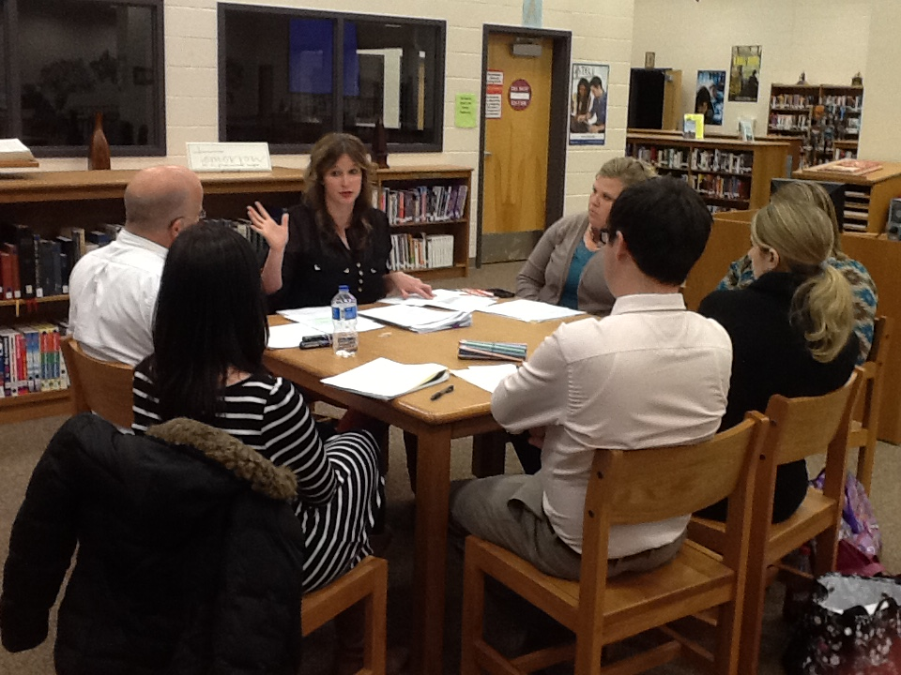
PD session on Literacy Middle/High School

Slide 14
ESL Interactive Writing/Language Learning and Vocabulary Development

Slide 15
K-3rd grade
TCAP-like Common Assessments
TCAP-like vocabulary throughout the year
Attending literacy and math trainings
Sharing with teachers within the schools and among grade level collaboration sessions

